Slide 1
Hold firm
Revelation 3:7-13

Slide 2
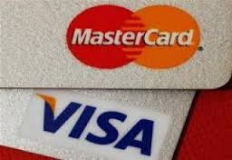
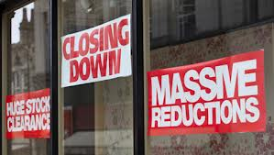
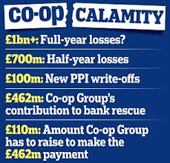
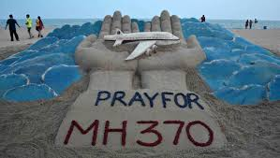
Hold firm
Revelation 3:7-13

Slide 3
Hold firm
Revelation 3:7-13
Surely the righteous will never be shaken; they will be remembered forever. They will have no fear of bad news; their hearts are steadfast, trusting in the Lord. Their hearts are secure, they will have no fear; in the end they will look in triumph on their foes” (Ps 112:6-8).

Slide 4
Hold firm
Revelation 3:7-13
“To the angel of the church in Philadelphia write: These are the words of him who is holy and true, who holds the key of David. What he opens no one can shut, and what he shuts no one can open. I know your deeds. See, I have placed before you an open door that no one can shut. I know that you have little strength, yet you have kept my word and have not denied my name. I will make those who are of the synagogue of Satan, who claim to be Jews though they are not, but are liars—I will make them come and fall down at your feet and acknowledge that I have loved you.

Slide 5
Hold firm
Revelation 3:7-13
Since you have kept my command to endure patiently, I will also keep you from the hour of trial that is going to come on the whole world to test the inhabitants of the earth. I am coming soon. Hold on to what you have, so that no one will take your crown. The one who is victorious I will make a pillar in the temple of my God. Never again will they leave it. I will write on them the name of my God and the name of the city of my God, the new Jerusalem, which is coming down out of heaven from my God; and I will also write on them my new name. Whoever has ears, let them hear what the Spirit says to the churches!

Slide 6
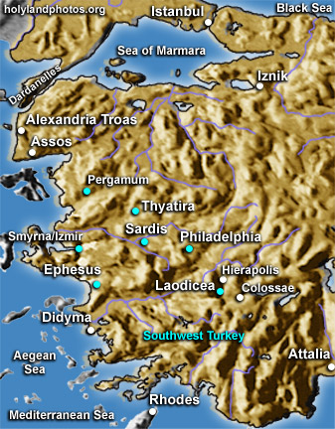
Hold firm
Revelation 3:7-13

Slide 7
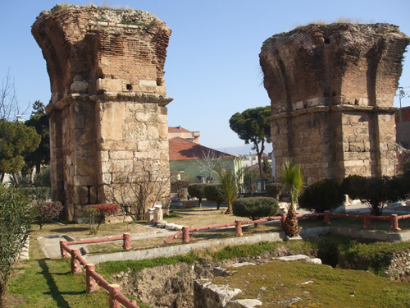
Hold firm
Revelation 3:7-13

Slide 8
Hold firm
Revelation 3:7-13
The Identity of the Speaker - “these are the words of him who is holy and true, and who hold the key of David”

Slide 9
Hold firm
Revelation 3:7-13
The Identity of the Speaker - “these are the words of him who is holy and true, and who hold the key of David”
Unmasking the false

Slide 10
Hold firm
Revelation 3:7-13
The Identity of the Speaker - “these are the words of him who is holy and true, and who hold the key of David”
Unmasking the false
Revealing the true

Slide 11
Hold firm
Revelation 3:7-13
The Identity of the Speaker
The Prophetic Message – “I know your deeds. See, I have placed before you an open door that no one can shut. I know that you have little strength, yet you have kept my word and have not denied my name”.

Slide 12
Hold firm
Revelation 3:7-13
The Identity of the Speaker
The Prophetic Message – “I know your deeds. See, I have placed before you an open door that no one can shut. I know that you have little strength, yet you have kept my word and have not denied my name”.
You have little strength

Slide 13
Hold firm
Revelation 3:7-13
The Identity of the Speaker
The Prophetic Message – “I know your deeds. See, I have placed before you an open door that no one can shut. I know that you have little strength, yet you have kept my word and have not denied my name”.
You have little strength
You have kept my name…

Slide 14
Hold firm
Revelation 3:7-13
The Identity of the Speaker
The Prophetic Message – “I know your deeds. See, I have placed before you an open door that no one can shut. I know that you have little strength, yet you have kept my word and have not denied my name”.
You have little strength
You have kept my name…
I have placed before you an open door

Slide 15
Hold firm
Revelation 3:7-13
The Identity of the Speaker
The Prophetic Message
The Divine Promise – “I will make those who are of the synagogue of Satan, who claim to be Jews though they are not, but are liars—I will make them come and fall down at your feet and acknowledge that I have loved you. Since you have kept my command to endure patiently, I will also keep you from the hour of trial that is going to come on the whole world”.

Slide 16
Hold firm
Revelation 3:7-13
The Identity of the Speaker
The Prophetic Message
The Divine Promise – “I will make those who are of the synagogue of Satan, who claim to be Jews though they are not, but are liars—I will make them come and fall down at your feet and acknowledge that I have loved you. Since you have kept my command to endure patiently, I will also keep you from the hour of trial that is going to come on the whole world”.
“My prayer is not that you take them out of the world but that you protect them from the evil one.” (John 17:15)

Slide 17
Hold firm
Revelation 3:7-13
The Identity of the Speaker
The Prophetic Message
The Divine Promise
Instructions and Promise – “I am coming soon. Hold on to what you have, so that no one will take your crown.”

Slide 18
Hold firm
Revelation 3:7-13
The Identity of the Speaker
The Prophetic Message
The Divine Promise
Instructions and Promise - I am coming soon. Hold on to what you have, so that no one will take your crown.
“Do you not know that in a race all the runners run, but only one gets the prize? Run in such a way as to get the prize. Everyone who competes in the games goes into strict training. They do it to get a crown that will not last, but we do it to get a crown that will last forever. Therefore I do not run like someone running aimlessly; I do not fight like a boxer beating the air. No, I strike a blow to my body and make it my slave so that after I have preached to others, I myself will not be disqualified for the prize” (1 Cor. 9:24-27).

Slide 19
Hold firm
Revelation 3:7-13
The Identity of the Speaker
The Prophetic Message
The Divine Promise
Instructions and Promise - I am coming soon. Hold on to what you have, so that no one will take your crown.
“I am coming/I will come” – 7 times in Revelation
(2:5, 16; 3:11; 16:15; 22:7, 12, 20) – of those, 4 times = “I am coming soon” (3:11; 22:7, 12, 20)

Slide 20
Hold firm
Revelation 3:7-13
The Identity of the Speaker
The Prophetic Message
The Divine Promise
Instructions and Promise
The Promise to the Overcomer - “The one who is victorious I will make a pillar in the temple of my God. Never again will they leave it. I will write on them the name of my God and the name of the city of my God, the new Jerusalem, which is coming down out of heaven from my God; and I will also write on them my new name.”

Slide 21
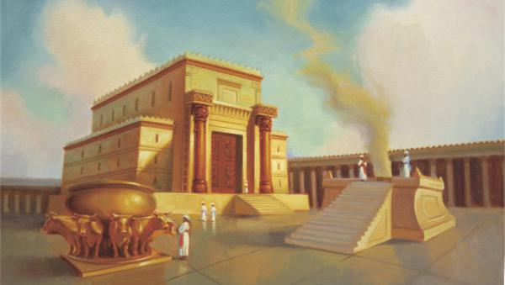
Hold firm
Revelation 3:7-13
The Identity of the Speaker
The Prophetic Message
The Divine Promise
Instructions and Promise
The Promise to the Overcomer

Slide 22
Hold firm
Revelation 3:7-13
The Identity of the Speaker
The Prophetic Message
The Divine Promise
Instructions and Promise
The Promise to the Overcomer
“But will God really dwell on earth with humans? The heavens, even the highest heavens, cannot contain you. How much less this temple I have built!” (2 Chron 6:18).

Slide 23
Hold firm
Revelation 3:7-13
The Identity of the Speaker
The Prophetic Message
The Divine Promise
Instructions and Promise
The Promise to the Overcomer
God’s message to us – “Hold Firm!”

Slide 24
Hold firm
Revelation 3:7-13
The Identity of the Speaker
The Prophetic Message
The Divine Promise
Instructions and Promise
The Promise to the Overcomer
God’s message to us – “Hold Firm!”
“Dear friends, do not be surprised at the fiery ordeal that has come on you to test you, as though something strange were happening to you” (1 Peter 4:12)

Slide 25
Hold firm
Revelation 3:7-13
The Identity of the Speaker
The Prophetic Message
The Divine Promise
Instructions and Promise
The Promise to the Overcomer
God’s message to us – “Hold Firm!”
Hold firm in our weakness

Slide 26
Hold firm
Revelation 3:7-13
The Identity of the Speaker
The Prophetic Message
The Divine Promise
Instructions and Promise
The Promise to the Overcomer
God’s message to us – “Hold Firm!”
Hold firm in our weakness
Hold firm to our identity

Slide 27
Hold firm
Revelation 3:7-13
The Identity of the Speaker
The Prophetic Message
The Divine Promise
Instructions and Promise
The Promise to the Overcomer
God’s message to us – “Hold Firm!”
Hold firm in our weakness
Hold firm to our identity
“Can you maintain a more steady calmness and serenity when God is striking at your dearest enjoyments in this world and acting most directly contrary to your present interests and to your natural passions and desires?” Philip Doddridge

Slide 28
Hold firm
Revelation 3:7-13
The Identity of the Speaker
The Prophetic Message
The Divine Promise
Instructions and Promise
The Promise to the Overcomer
God’s message to us – “Hold Firm!”
Hold firm in our weakness
Hold firm to our identity
“If then you have been raised with Christ, seek the things that are above, where Christ is, seated at the right hand of God. Set your minds on things that are above, not on things that are on earth. For you have died, and your life is hidden with Christ in God. When Christ who is your life appears, then you also will appear with him in glory” (Col 3:1-4).

Slide 29
Hold firm
Revelation 3:7-13
Doxology
To him who is able to keep you from stumbling and to present you before his glorious presence without fault and with great joy— to the only God our Saviour be glory, majesty, power and authority, through Jesus Christ our Lord, before all ages, now and forevermore! Amen. (Jude 24-25)

